Slide 1
Evaluation of WKFRAME3 catch rule
José De Oliveira, Chris Darby, Carmen Fernández and Carl O’Brien

Slide 2
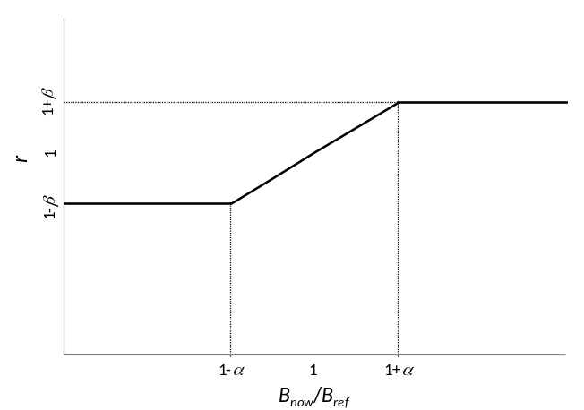
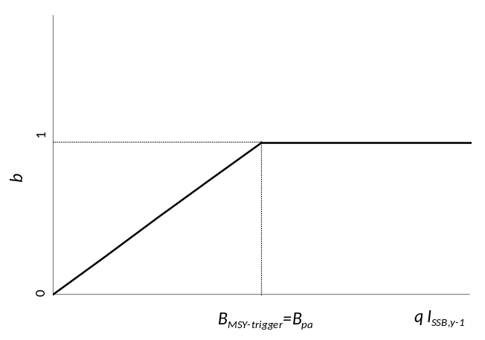
WKFRAME3 Catch Rule
TAC_{y+1} = r b f TAC_{y}
r b f
X_{MSY}/
[C_{y-1}/(qI_{SSB,y-1})]
where:
X_{MSY}=MSYR
=MSY/B_{MSY}
TAC constraint (±20%)

Slide 3
Preliminary Investigations
Switch factors on/off
Get rid of 1-year lag in f and b
Switch TAC constraint on

Slide 4
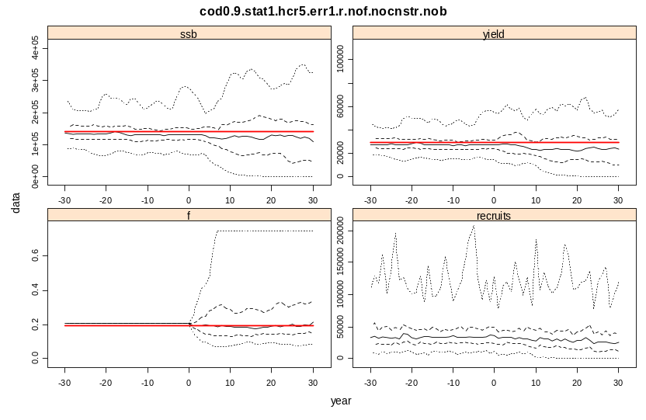
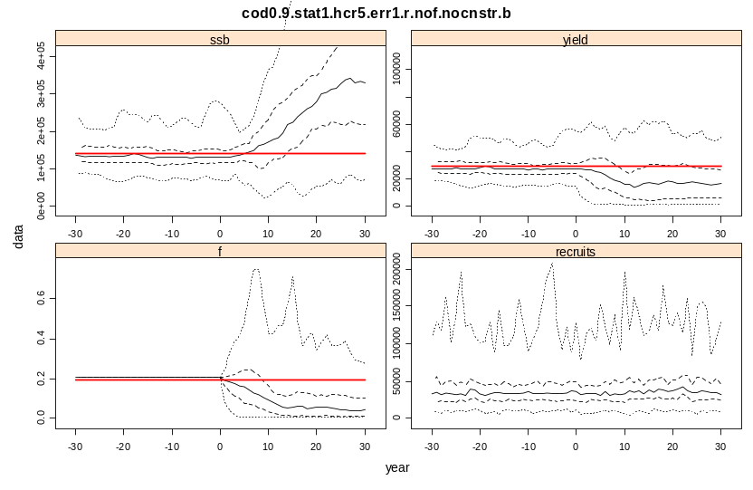
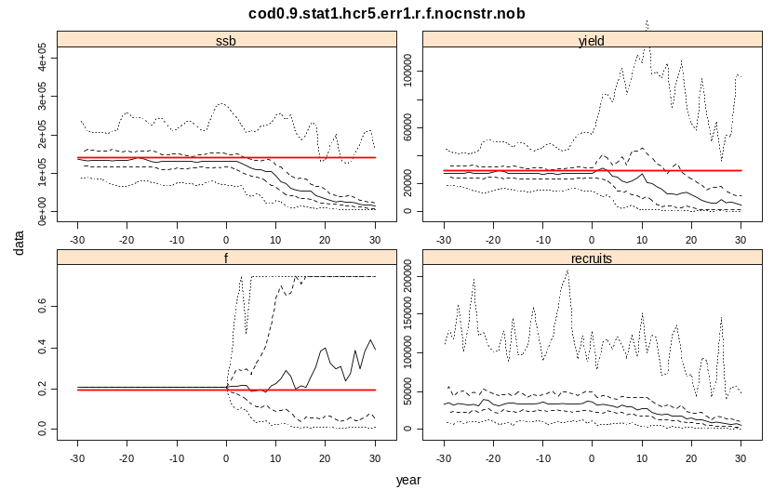
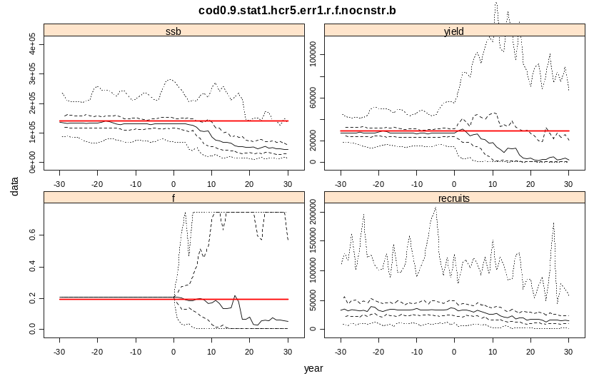
1. Switch factors on/off
Switch b on
Switch f on

Slide 5
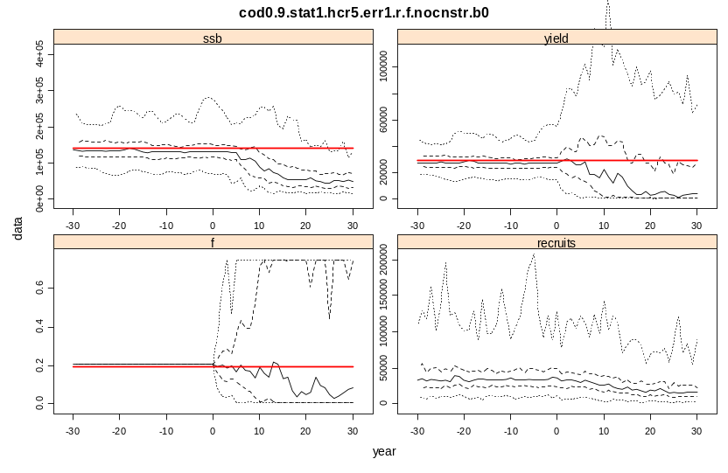
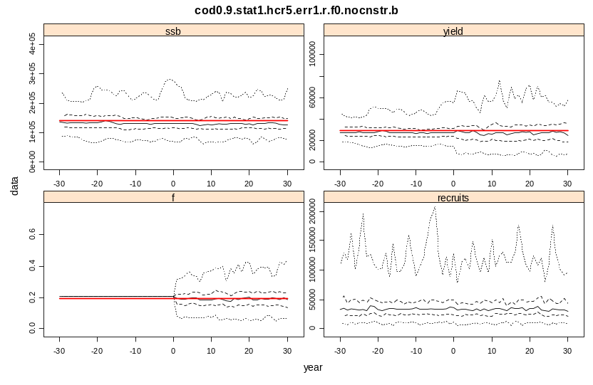
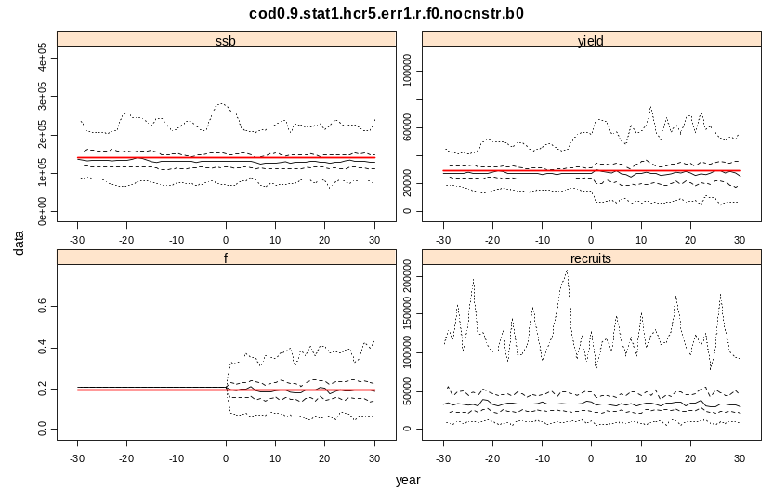
2. Get rid of 1-year lag in f and b
Omit 1-yr lag in b
Omit 1-yr lag in f

Slide 6
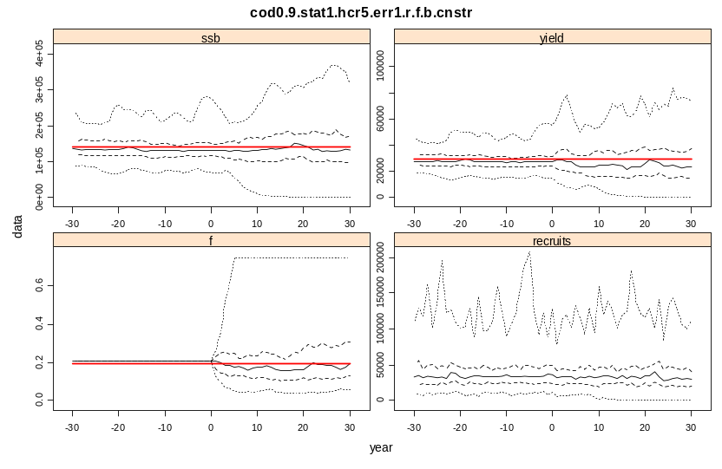
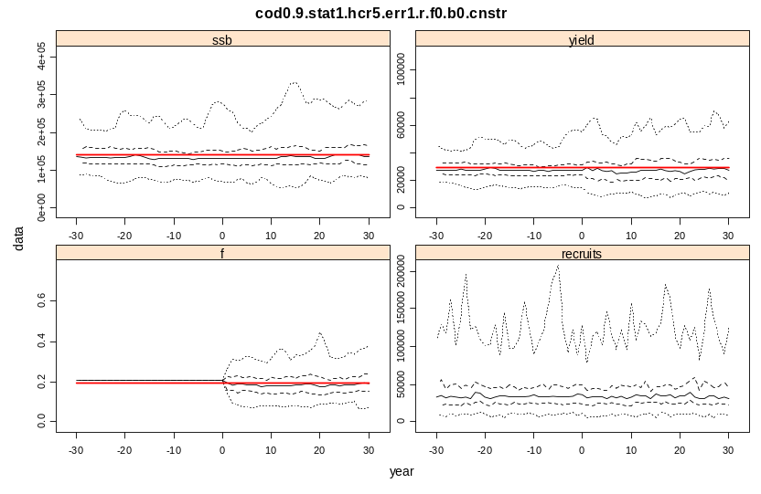
3. Switch TAC constraint on
With 1-yr lag in f & b
Without 1-yr lag in f & b
TAC constraint off
TAC constraint on
Notes:
The Highlighted run gets the full-design treatment (scenarios x HCR variants); the other options run only for scenarios (i.e. berr=1 and ferr = 1)

Slide 7
Options considered
Variations on HCR
  Error in b: B_{MSY-trigger} = berr×B_{pa}
  (berr = 0.5, 1.0, 1.5)
  Error in f: X_{MSY} = ferr ×MSYR
  (ferr = 1.5, 1.0, 0.5)
Scenarios
  Status: Well managed (F~F_{MSY}, SSB~B_{MSY}) or Overfished (F>F_{MSY}, SSB<B_{MSY})
  Productivity: Steepness = 0.9 or 0.75
  Observation: CV=30% with or without q-trend

Slide 8
Results
Full Design (HCR variations×Scenarios): Rule without lag & with TAC constraint
Scenarios only (berr=1, ferr=1) on:
  Rule without lag & without TAC constraint
  Rule with lag & with TAC constraint
  Rule with lag & without TAC constraint

Slide 9
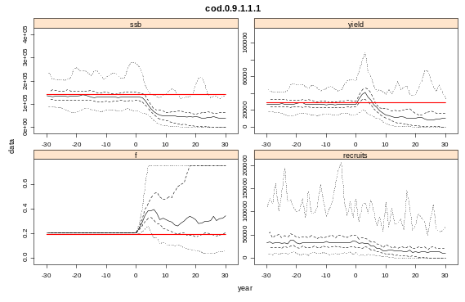
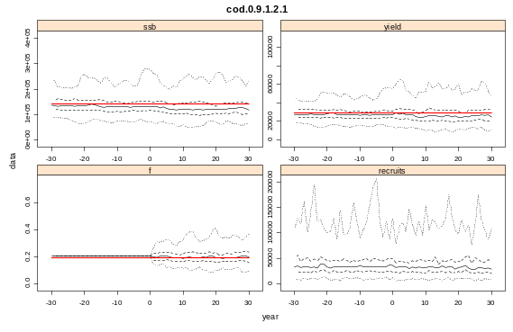
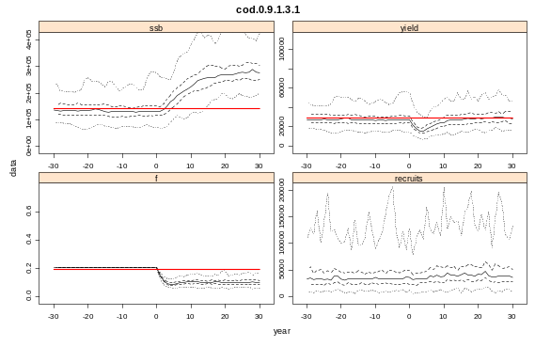
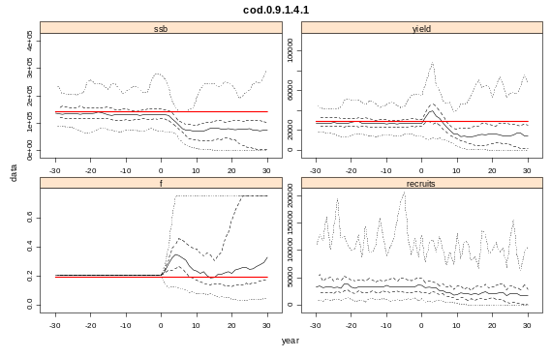
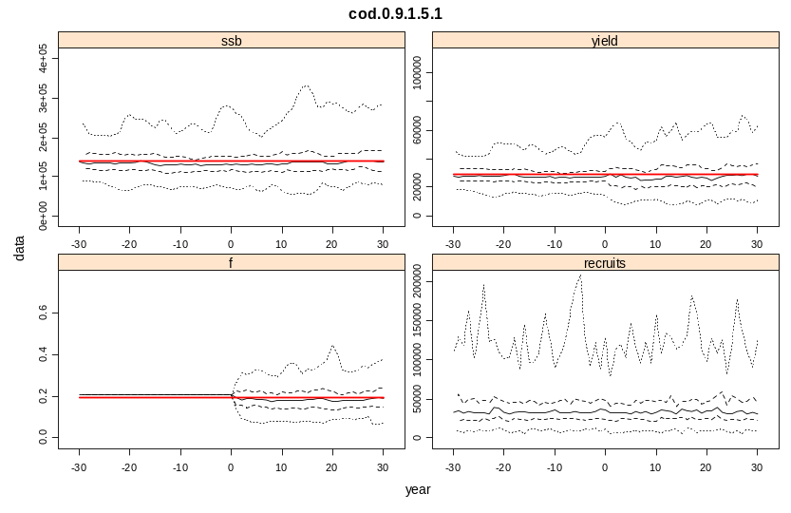

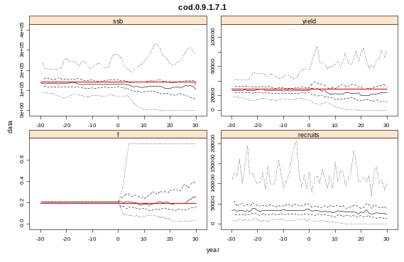


Full Design
[status = well managed, steepness = 0.9, no q-trend]
ferr=1.5
ferr=1.0
ferr=0.5
berr=0.5
berr=1.0
berr=1.5

Slide 10
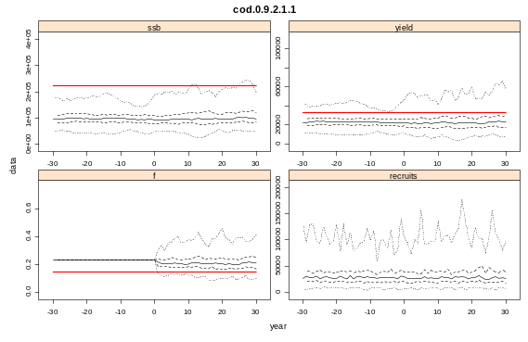
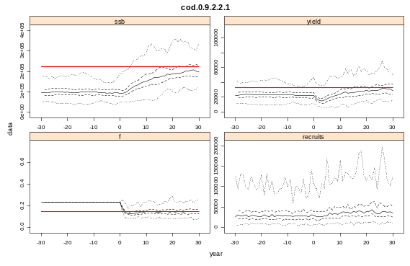
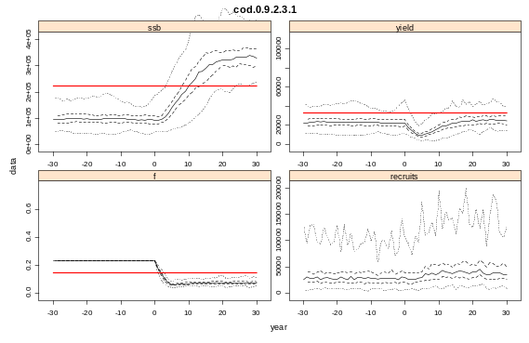
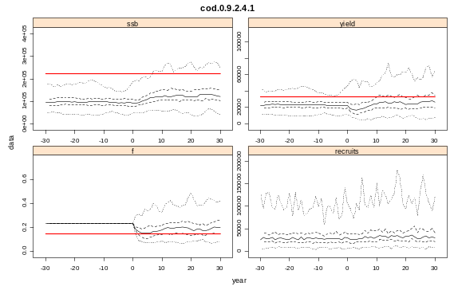
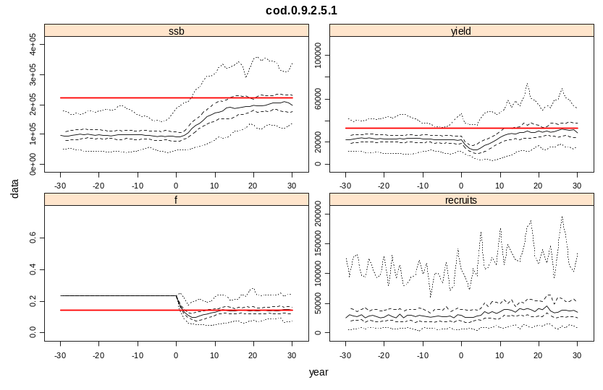

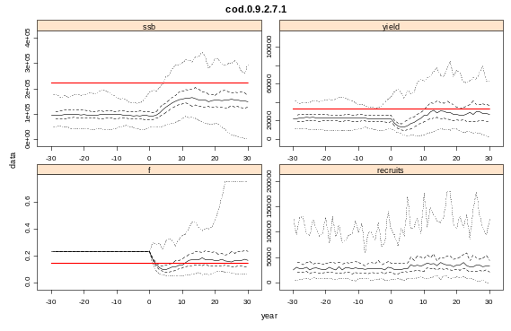
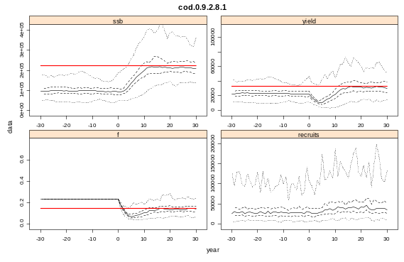
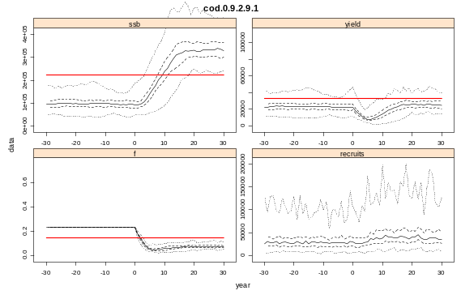
Full Design
[status = overfished, steepness = 0.9, no q-trend]
ferr=1.5
ferr=1.0
ferr=0.5
berr=0.5
berr=1.0
berr=1.5

Slide 11
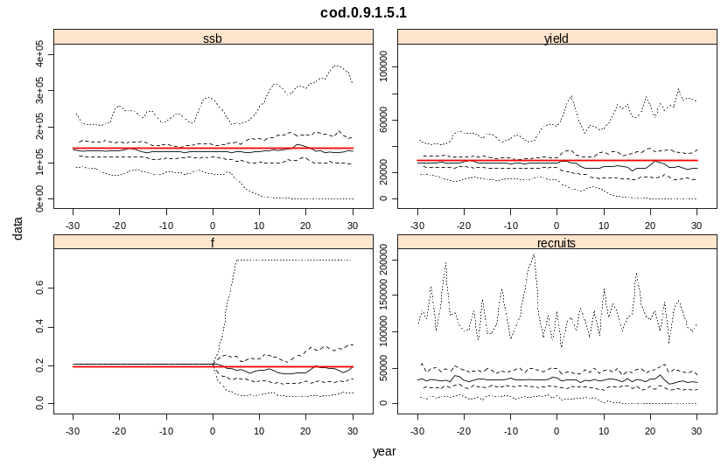
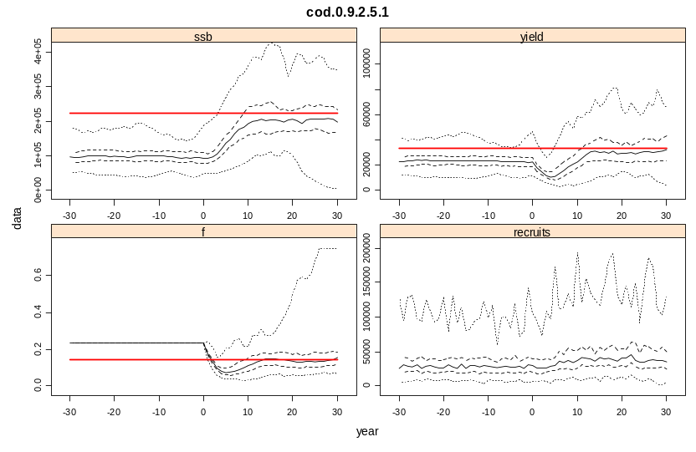
Scenarios Only
[With TAC constraint, steepness = 0.9, no q-trend]
Status = well managed
Status = overfished
With 1-yr lag in f & b
Without 1-yr lag in f & b

Slide 12
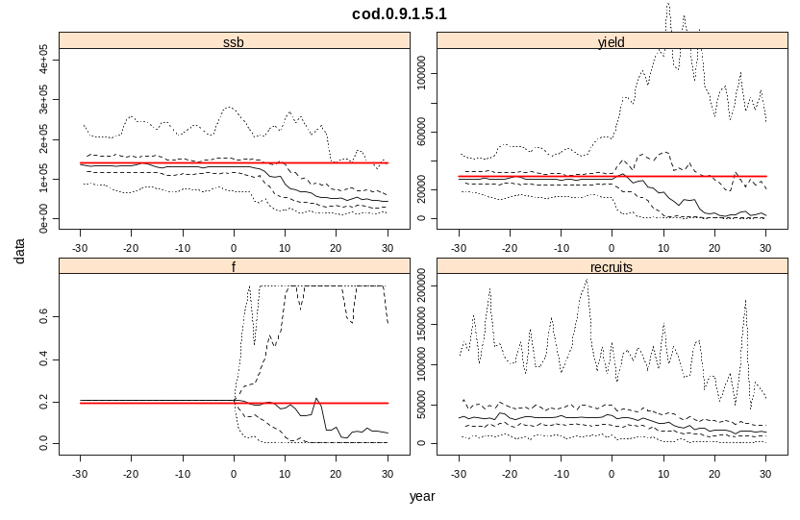
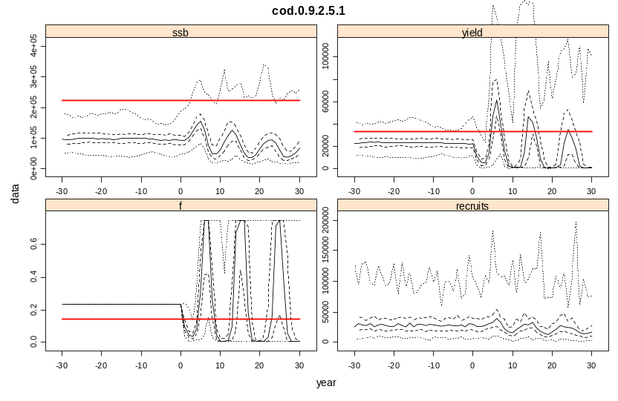
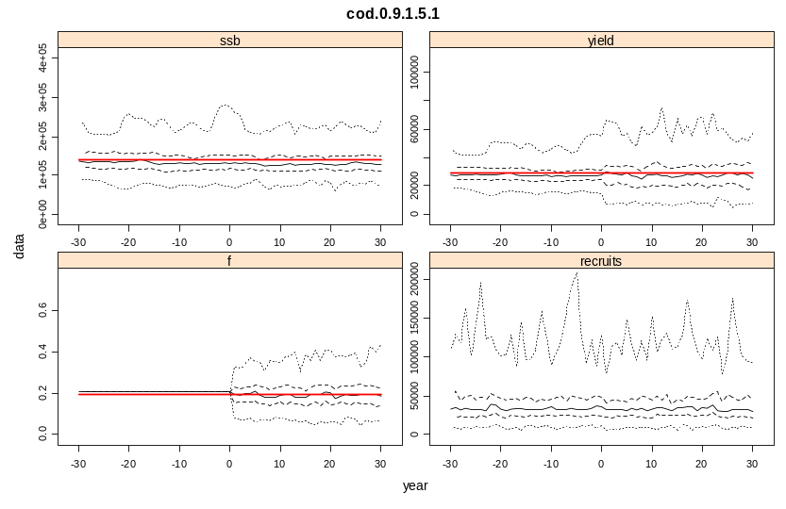
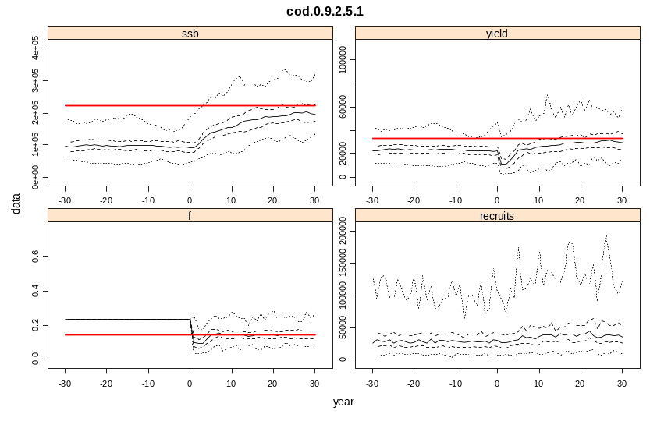
Scenarios Only
[Without TAC constraint, steepness = 0.9, no q-trend]
Status = well managed
Status = overfished
With 1-yr lag in f & b
Without 1-yr lag in f & b

Slide 13
Conclusions
Unbiased estimates of MSYR, exploitation rate and survey catchability are needed for the rule to deliver MSY targets
Where a 1-year lag in the calculation of factor f is unavoidable:
  a TAC constraint is needed to stabilise the HCR
  there are a greater number of low SSB values compared to the HCR with no lag, implying a substantially greater risk of e.g. SSB<B_{lim}
When applying factor b in combination with the TAC constraint, it is better to set B_{MSY-trigger} too high than too low

